Slide 1
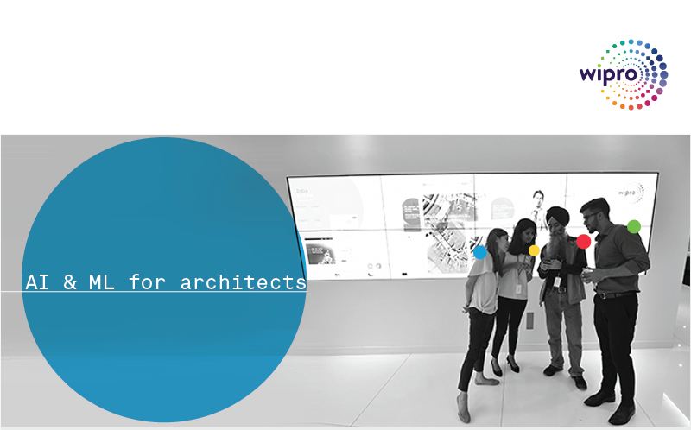
Introduction to AI and ML – Level 2 Gururajan Narasimhan Erode

Slide 2
Agenda for Level 2
Summary of our previous session
Introduction to the different techniques of machine learning –
Classification and Regression
Clustering and Density Estimation
Dimensionality Reduction and Anamaly Detection
Recommendation and Association Rule Mining
Time Series Analysis and Ensemble Learning
Reinforcement Learning and Genetic Algorithms
Ranking
Algorithms under each technique of machine learning
Libraries used in machine learning, data mining, speech processing, computer vision, robotics and NLP

Slide 3
What is Machine Learning – Tom Mitchell - Review
The domain of machine learning is related to the question of how to build computer programs that by themselves (automatically) improve or LEARN from experience.
“A computer program is said to learn from experience E with respect to some class of tasks T and performance measure P if its performance at tasks in T, as measured by P, improves with experience E. …”
– Tom Mitchell
Tom M. Mitchell provided a widely quoted and more formal definition of the algorithms studied in the machine learning field. (The above definition and it is attributed to Tom Mitchell)
The important word here is Learning
What do we mean by the phrase “ I am Learning” ?
The ability to comprehend and improve my work based on experience

Slide 4
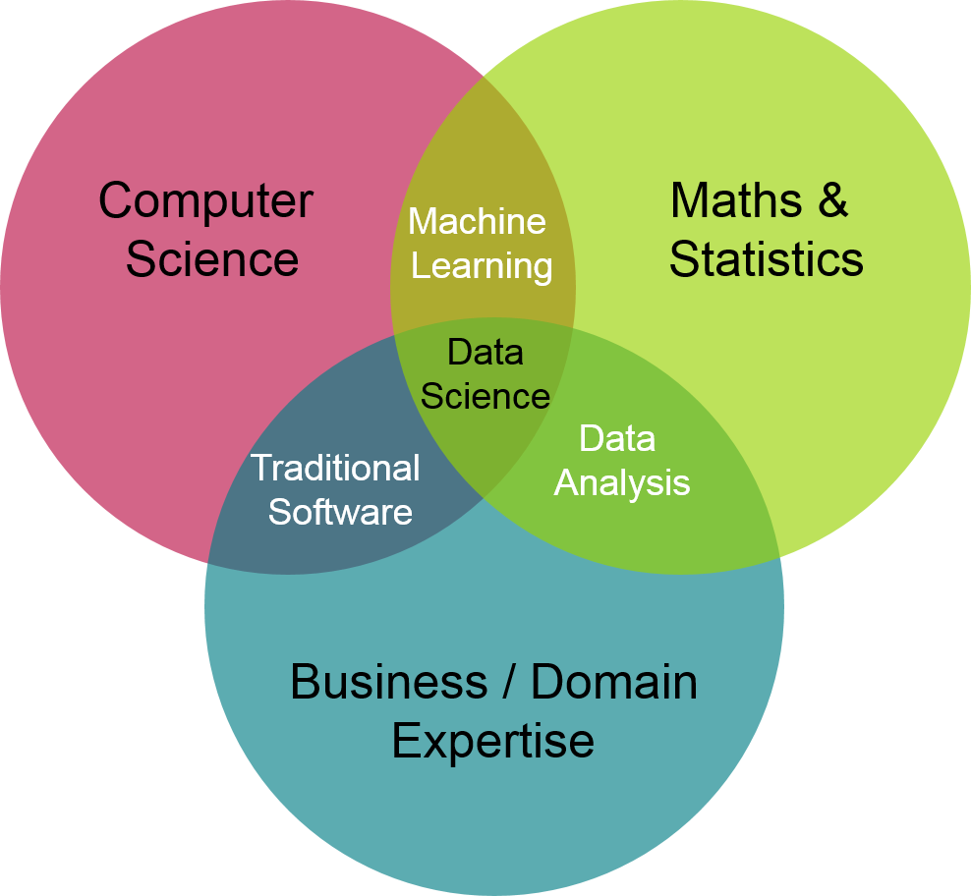
Machine Learning and Related Fields – Review
Picture credit: https://ion.icaew.com/itcounts/b/weblog/posts/theaccountinganddatascienceworldsmeet

Slide 5
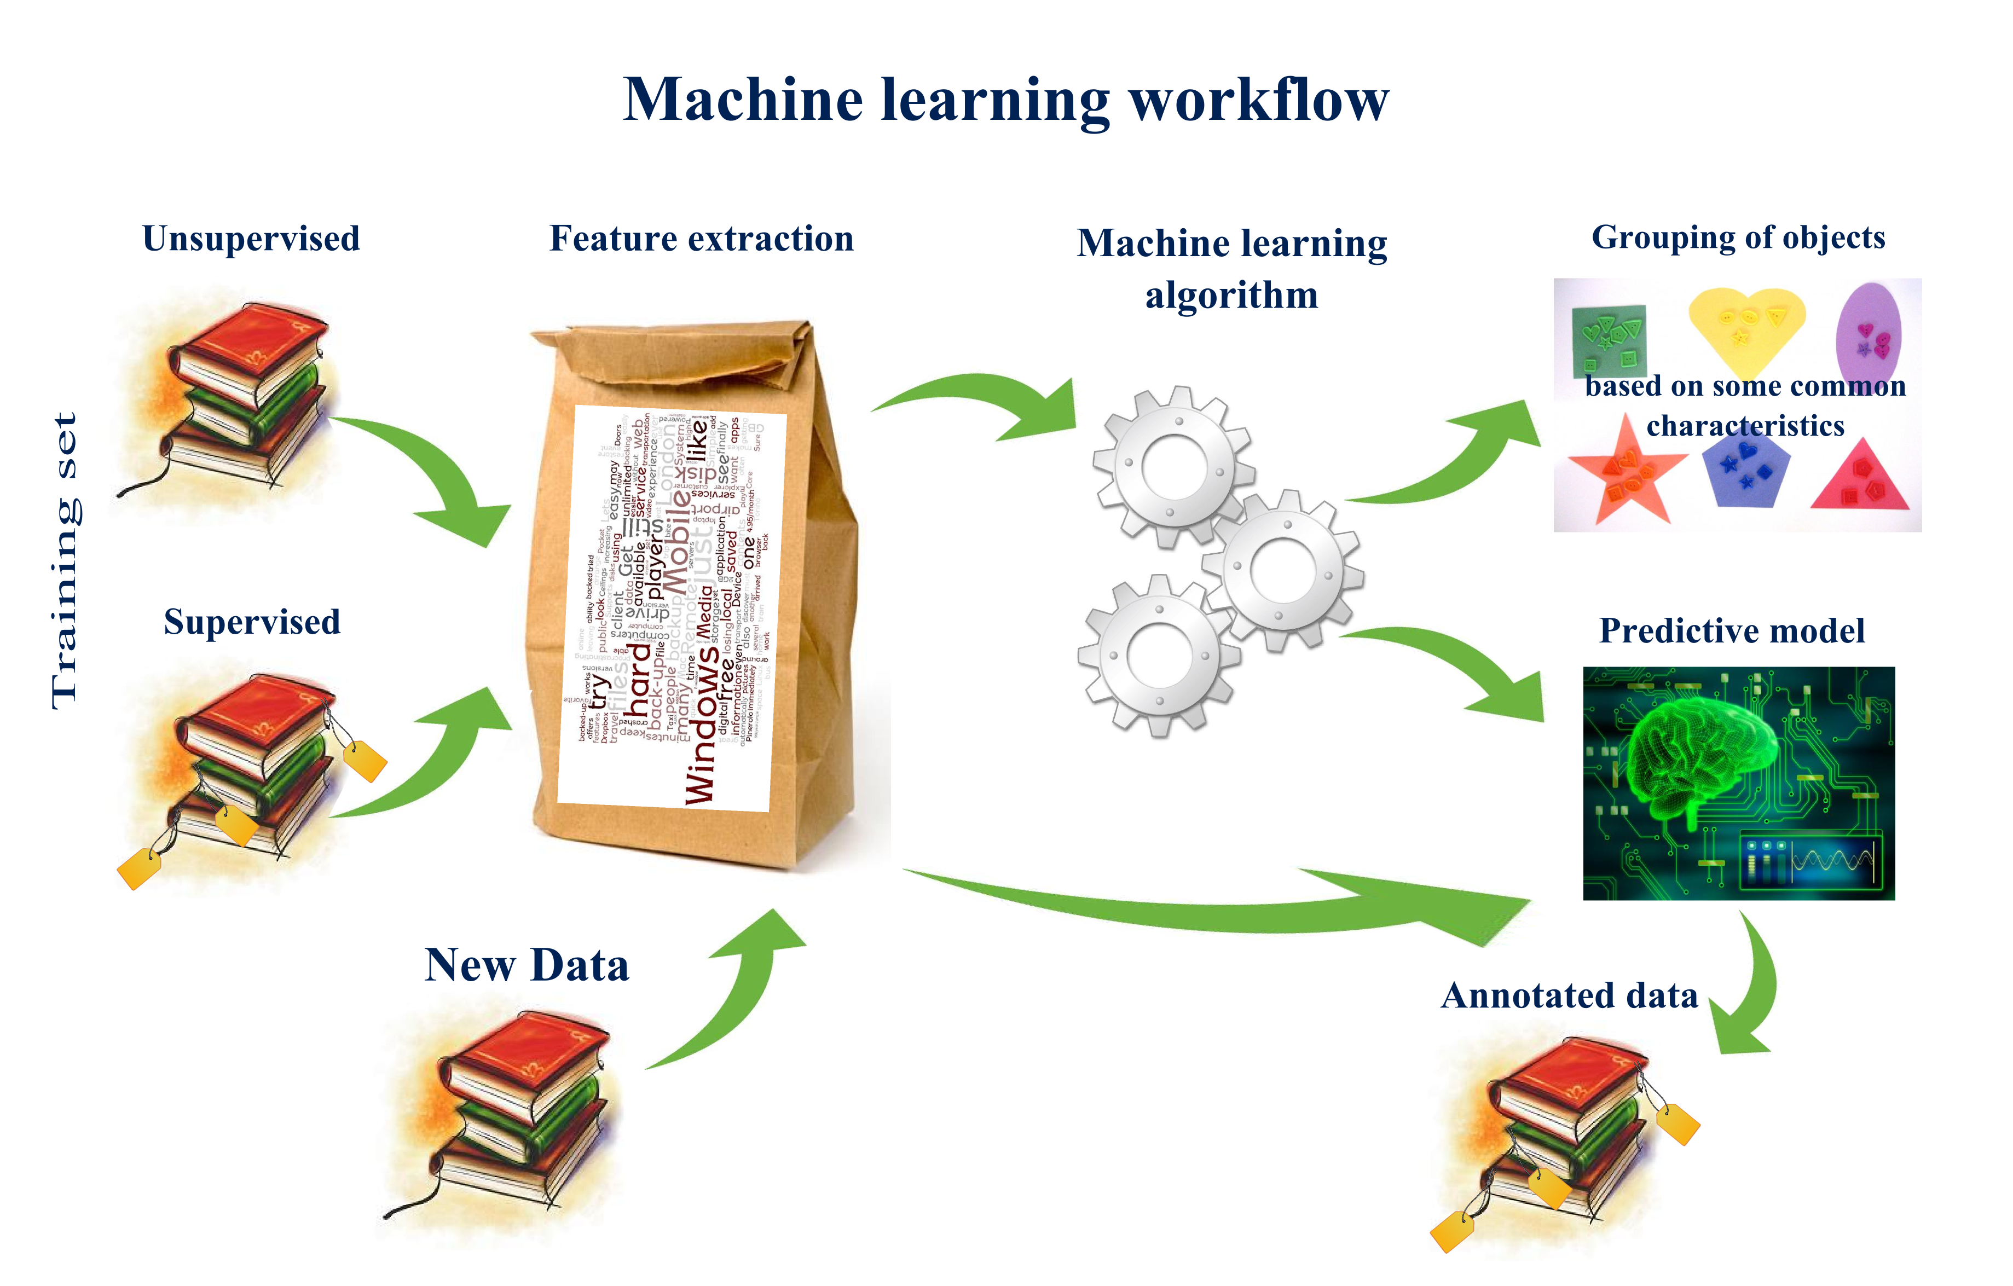
Review
Picture credit: http://nkonst.com/machine-learning-explained-simple-words/

Slide 6
Types of Models
Parametric Vs Non-Parametric Model
Generative Vs Discriminative Model
Linear (GLM) Vs Non-linear Models
Probabilistic model, Bayesian model
Markov model

Slide 7
Machine Learning Techniques – a comparison with humans
What humans do | Name of that technique in Machine Learning
Predict the class of data | Classification or Categorization
Predict a numerical value, continuously varying value | Regression
Group items or products or customers to different meaningful groups | Clustering
Show similar items or products | Recommendation
Associate a new item with already selected items | Association Rule Mining
Analyze and extract knowledge from chronological data | Time Series Analysis
Choose the most important features | Dimensionality Reduction

Slide 8
Machine Learning Techniques – a comparison with humans
What humans do | What is the that technique in Machine Learning
Fit an appropriate distribution for the given data to gather density and peak information | Density estimation
Combine many methods to get a best result | Ensemble learning
Find the odd man out in the given data | Outlier detection or Novelty detection or Anomaly detection
Simulate the way the brain works and find a solution to a problem | Neural networks and deep learning – (our next session – Day 3)
Top 10 movies, Top 10 songs, Top 10 stocks to pick, Top 10 colleges to study | Ranking
Learn from criticism and praise | Reinforcement Learning
Understand how the genes retain and keep information and improvise | Genetic Algorithms

Slide 9
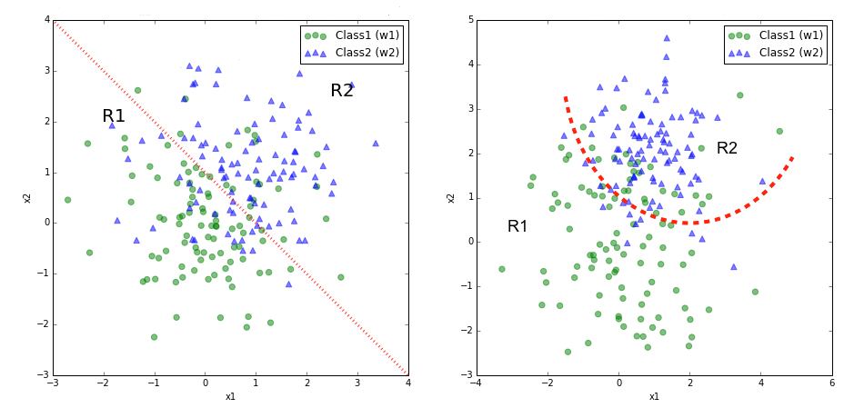
Classification examples
Finding the type of a flower
Finding if a person has a chance of getting diabetes or not
Classifying if a currency note is fake or real (fake currency detection)
Finding if a person will repay the loan or will default (also called credit risk assessment)
Finding the name of the author among the given 5 or 6 writers
Classifying the words as different parts of speech (POS)
Classifying the sentiment in the given review or sentence from 1 to 5

Slide 10

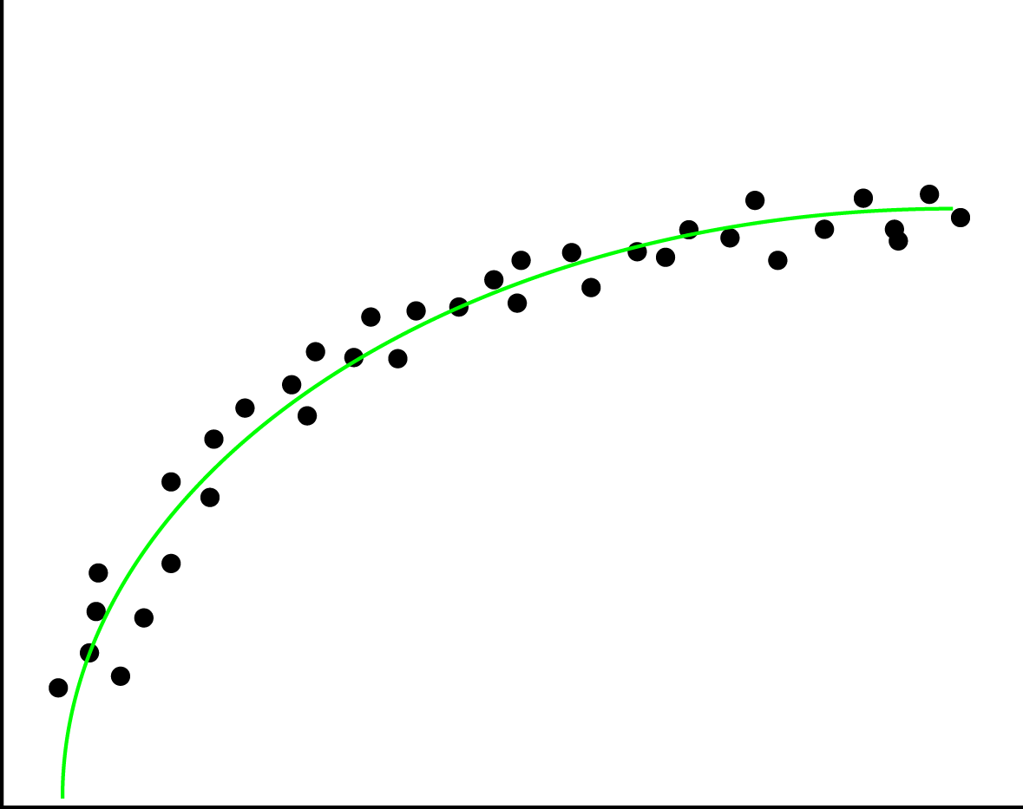
Picture credit: https://en.wikipedia.org/wiki/Linear_regression
Regression examples
Predicting the price of a house in a given area
Predicting the CGPA of a student from the given data
Predicting the revenue of the company based on the money spent on advertising
Predicting the wind speed, temperature and humidity tomorrow based on weather data so far
Predicting the fuel costs for the next five years for the airlines given the consumption pattern
Finding if a person will repay the loan or will default
Prediction of the energy demand in the district, state and country based on consumption patterns
Picture credit: https://xyclade.github.io/MachineLearning/

Slide 11
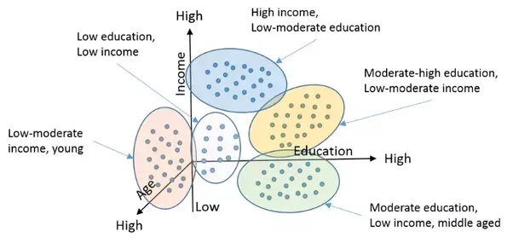
Clustering examples
Grouping a set of objects in such a way that objects in the same group are more similar to each other than to those in other groups
Grouping the customers in the retail domain for better targeting
Grouping movies based on dollars spent and the box office
Grouping people based on their income, age and education
Grouping people for insurance based on insurance claims
Picture credit: https://www.quora.com/What-is-the-difference-between-Clustering-and-Classification-in-Machine-Learning

Slide 12
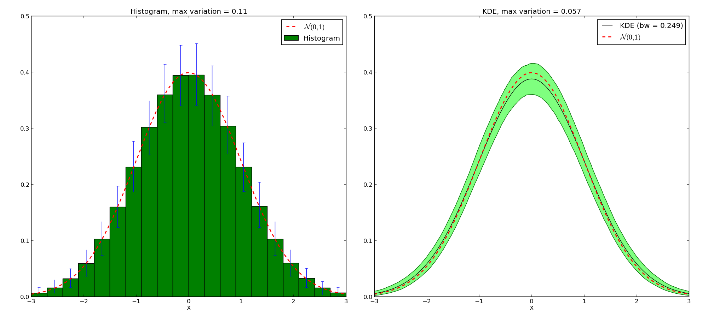
Density Estimation examples
Picture credit: http://pyqt-fit.readthedocs.io/en/latest/KDE_tut.html
Finding out the life expectancy in the population data
Finding the age group to target for insurance offerings in the given population
Pathological findings in the country given the population distribution

Slide 13
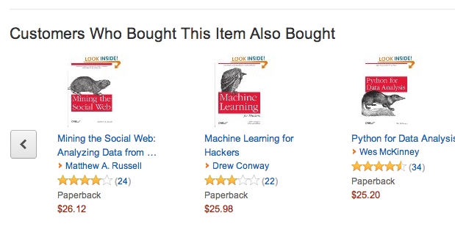
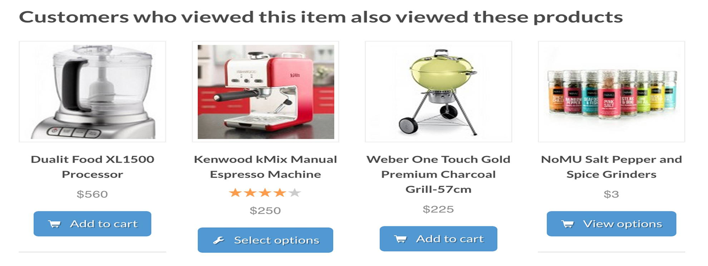
Recommendation examples
Recommending a product for online buyers
Recommending books online
Movie recommendation for users on Netflix
Finding if a person will repay the loan or will default (also called credit risk assessment)

Slide 14
Classification algorithms
Clustering algorithms
KNN – K Nearest Neighbors
Naïve Bayes
Bayesian Networks
Perceptron
Support Vector Machines (SVM)
Decision Trees
Random Forests
Deep learning based (CNN based) classification
Logistic Regression
K – Means
Fuzzy K-Means
Mean Shift
DBSCAN
OPTICS
Hierarchical Clustering
BIRCH (Balanced Iterative Reducing and Clustering using Hierarchies)

Slide 15
Regression algorithms
Simple linear regression or uni-variate linear regression
multiple linear regression or multi-variate linear regression
logistic regression (used in classification)
polynomial linear regression
nonlinear regression
least squares regression
gradient descent algorithm
Kernel based regression
Types of gradient descent algorithms for solving regression problems
batch gradient descent
stochastic gradient descent
normal equation for solving regression problems
Types of regularization technique used in regression
1. LASSO regression (Least Absolute Shrinkage and Selection Operator)
2. ridge regression
3. elastic net

Slide 16
Recommender algorithms
Recommendation Systems
Content based filtering technique
Collaborative filtering technique
Hybrid filtering technique
Model based filtering technique
Memory based filtering technique
Clustering techniques
Association techniques
Bayesian networks
Deep learning based
User based
Item based

Slide 17
Association rule mining algorithms
FP Growth – Frequent Pattern Mining
Apriori – (lift, confidence and support)
ECLAT – Equivalence Class Transformation
Market basket analysis

Slide 18
Time Series Analysis methods
Simple Moving Average (SMA)
Exponential Smoothing (SES)
Autoregressive Integration Moving Average (ARIMA)
Neural Network (NN)
Croston

Slide 19
Dimensionality Reduction techniques
Principal Component Analysis (PCA)
Factor Analysis
Canonical Component Analysis (CCA)
Factor Analysis
Independent Component Analysis (ICA)
Linear Discriminant Analysis (LDA)
Non-negative matrix factorization
T-distributed stochastic neighbour embedding

Slide 20
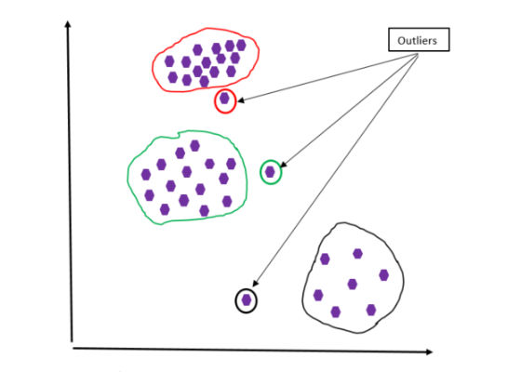
Outlier detection, novelty detection or anomaly detection techniques
Density based techniques
Cluster analysis based outlier detection
Fuzzy logic based outlier detection techniques
Subspace and correlation based outlier detection for high dimensional data
Plotting (visual techniques)

Slide 21
Applications of Outlier Detection
Credit card fraud detection and statistical methods
Fraudulent insurance claims in hospitals and fraudulent life insurance claims
Activity monitoring—the detection of fraud of mobile phones and proximity-based methods
Detection of network security breach – finding something unusual in traffic
Intrusion detection and density-based methods
Medical Diagnosis
Monitoring the performance of network-based and classification-based methods
Detecting novelty in text, topic detection, and mining contextual outliers
Video surveillance and unusual footage in it

Slide 22
Types of Ensemble Learning
Bagging (bootstrap aggregating)
Adaboost
Boosting
Stacking
Random forest

Slide 23
Density estimation techniques
Expectation maximization
Parzen windows
Vector quantization
Rescaled histogram (most popular estimation technique)
Kernel density estimation
Many clustering techniques

Slide 24
Reinforcement Learning Techniques
SARSA – State Action Reward State Action
Q-Learning – ‘Q’ means Quality – quality of an action in a given state
DQN – Deep Q Network
DDPG – Deep Deterministic Policy Gradient

Slide 25
Genetic Algorithms working
Population of
individuals or alternative
(feasible) solutions
Next generation
of
individuals
Evaluate individuals
on their fitness
Differential Reproduction
Select individuals
based on fitness
for subsequent mating
Arbitrarily change
some characteristic
Genetic Variation
Select individuals
& exchange charac-
teristics to create
new individuals
Heredity
Mating pool of
“fitter”
individuals

Slide 26
Genetic Algorithms - Applications
Optimizing schedules -
Optimizing portfolios – (stock market and in organizations)
Analyzing protein structure
Optimizing engineering processes – (shop floor and process planning)
Route optimization
Optimum layout – VLSI design layout, city area layout
Optimal packaging
Engineering component design, equipment design

Slide 27
Top 10 Algorithms
Naïve Bayes Classifier Algorithm
K Means Clustering Algorithm
Support Vector Machine Algorithm
Apriori Algorithm
Linear Regression
Logistic Regression
Artificial Neural Networks
Random Forests
Decision Trees
Nearest Neighbours

Slide 28
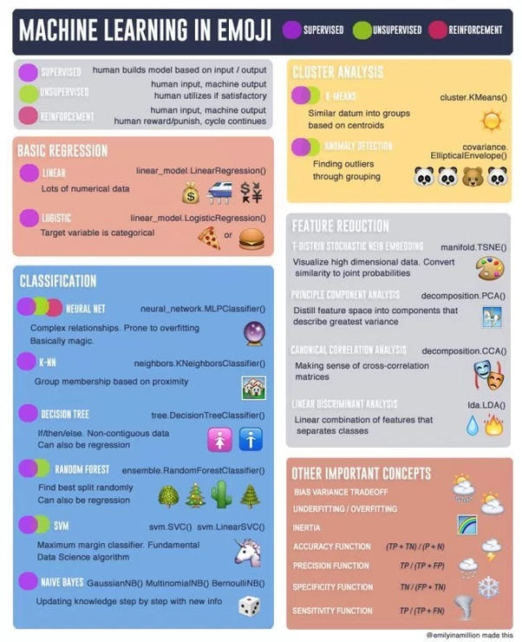
Picture credit is given to: please see -> https://www.datasciencecentral.com/profiles/blogs/the-making-of-a-cheatsheet-emoji-edition

Slide 29
Machine Learning and Data Mining frameworks
Numpy – Jim Hugunin, Travis Oliphant, 2005, python
Scipy - python
ScikitLearn – from google – 2007 – Google summer of code project, - python
Jupyter Notebook, - python
Matplotlib - python
Statsmodels - python
Pandas – 2005, 2006 - python
Rstudio – for R language
SAS (Statistical Analysis System – 50 years old, in C)
Rapid Miner
SPSS (Statistical Package for Social Sciences – from IBM – 50 years old, written in Java)
Weka – Waikato Environment for Knowledge Analysis, Java, University of Waikato, Newzealand
KNIME (Konstanz Information Miner from Germany, Java, 2006)
Tensor flow, python and C++
Keras, python and C++
Microsoft CNTK, C++, Visual C++
Amazon ML
Editors and IDEs
Rstudio , Pycharm, Vim, Emacs
Languages, Visual Studio
Python, R, C++, Scala, Lua & Clojure

Slide 30
Natural language processing and computer vision frameworks
Natural Language Processing
NLTK – Natual Language Processing Toolkit
Textblob
Open NLP
Stanford NLP
GATE – General Architecture for Text Engineering
MATLAB
Amazon lex
Computer Vision
Deep dream - google
Open CV
MATLAB
Bing Vision - microsoft
Amazon Rekognition - amazon

Slide 31
Robotics and Speech Recognition frameworks
Robotics
Robotics Software Development frameworks
Robot Mind
Fawkes
Robot Operating System
Robotics Development Studio - - microsoft
Speech Recognition
Bing speech API – from microsoft
Amazon – poly API
Google speech recognition API
Simon
Kaldi
Julius

Slide 32
Demonstrations
C:\Users\Gururaj\Desktop\Demostrations\Speed Sign Recognition by Convolutional Neural Networks.mp4
C:\Users\Gururaj\Desktop\Demostrations\Speed Sign Recognition by Convolutional Neural Networks 2.mp4
C:\Users\Gururaj\Desktop\Demostrations\Volkswagen Tiguan Automatic Parking Demonstration.mp4
https://www.youtube.com/watch?v=_qah8oIzCwk
https://www.youtube.com/watch?v=0FW99AQmMc8

Slide 33
References
https://www.bistasolutions.com/resources/blogs/5-statistical-methods-for-forecasting-quantitative-time-series/
Machinelearningmastery.com

